Slide 1

Introduction to Python
By Source (WP:NFCC#4), Fair use, https://en.wikipedia.org/w/index.php?curid=44458281

Slide 2
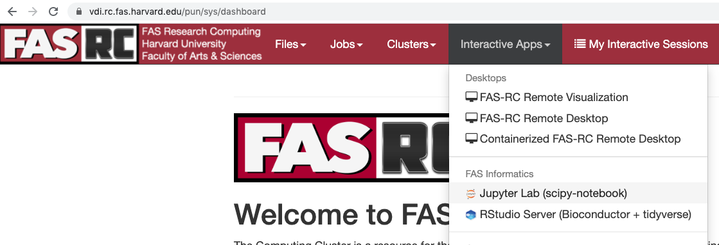
Course setup
Go to vdi.rc.fas.harvard.edu

Slide 3
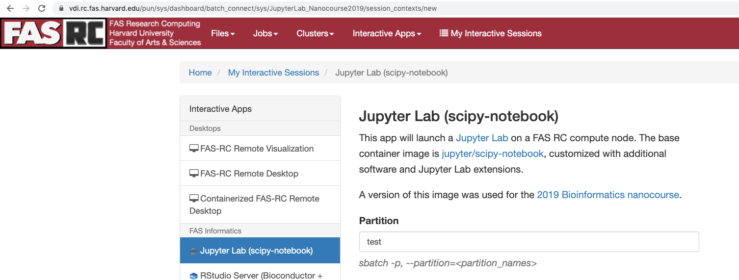
Course setup
On this page make sure you have
partition: test
Reservation: informatics_workshop
Slurm account: informatics_workshop

Slide 4
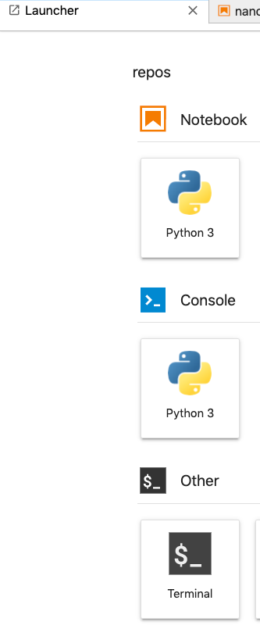
Clone the course materials
From Jupyterlab open a terminal:
Singularity> pwd
/n/home_rc/mportermahoney
Singularity> cd repos/
Singularity> pwd
/n/home_rc/mportermahoney/repos
Singularity> git clone https://github.com/harvardinformatics/micro-course.git
Cloning into 'micro-course'...
remote: Enumerating objects: 62, done.
remote: Counting objects: 100% (62/62), done.
remote: Compressing objects: 100% (41/41), done.
remote: Total 754 (delta 42), reused 41 (delta 21), pack-reused 692
Receiving objects: 100% (754/754), 110.82 MiB | 35.51 MiB/s, done.
Resolving deltas: 100% (376/376), done.
Checking out files: 100% (99/99), done.

Slide 5
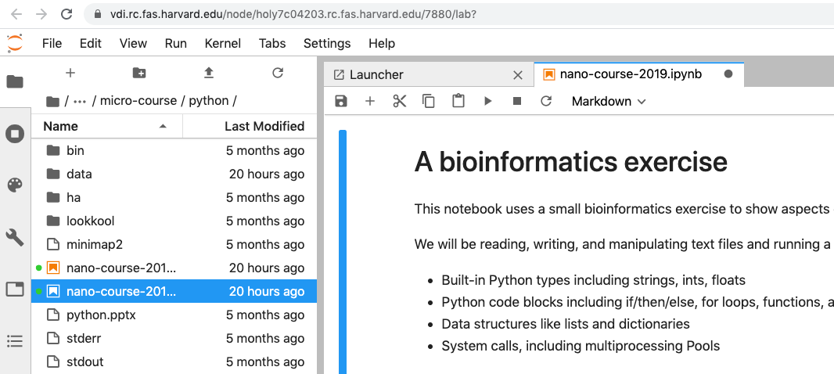
Open the course notebook
Open micro-course/python/nano-course-2019.ipynb

Slide 6
Why Python’s Great
An interpreted language
Python is processed at runtime by the interpreter. Don’t need to compile separately.
Python source code (*.py) compiles to bytecode (*.pyc) that represents instructions to the Python interpreter
Slower than compiled C, faster than shell scripts
Clean, pseudocode-like syntax
Small number of syntactic elements (no special line terminator, {}, () rarely used)
Consistent indentation is a structural element
Object-oriented, also provides multi-paradigm support
Everything in python is an object defined by a class
Procedural
Functional (lambda, map, reduce)
A wildly successful environment
PyPI includes > 190,000 packages
Strong scientific computing support, web frameworks
Jupyter project

Slide 7
Jupyter Lab
Jupyter Lab is a web-based, multi-language execution environment
Successor to IPython Notebook, Jupyter Notebook
Code cells supports interpretation of Python, R, Julia, et al.
Markdown cells are used for (description, annotation, comments)

Slide 8
Python uses object-oriented classes
A “class” is an advanced type that can combine data and operations on that data
class Point(object):
def __init__(self, x, y):
self.x = x
self.y = y
def isOrigin(self):
if self.x == 0 and self.y == 0:
return True
else:
return False
def __str__(self):
return '(%d, %d)' % (self.x, self.y)

Slide 9
Python uses object-oriented classes
# Create a Point by calling __init__
[ ]: point1 = Point(0,0)
[ ]: type(point1)
Point
# Dot (.) operator accesses class functions
[ ]: point1.isOrigin()
True
# Dot also accesses class data
[ ]: point1.x
0
# print() uses the __str__ function
[ ]: print(point1)
(0,0)
class Point(object):
def __init__(self, x, y):
self.x = x
self.y = y
def isOrigin(self):
if self.x == 0 and self.y == 0:
return True
else:
return False
def __str__(self):
return '(%d, %d)' % (self.x, self.y)

Slide 10
String literals are objects with functions
# Create a str by calling str.__init__
[ ]: string_literal = 'string_literal'
[ ]: type(string_literal)
str
# Dot (.) operator accesses class functions
[ ]: 'string {}'.format('literal')
'string literal'
# Capitalize it
[ ]: 'string literal'.capitalize()
'String literal'

Slide 11
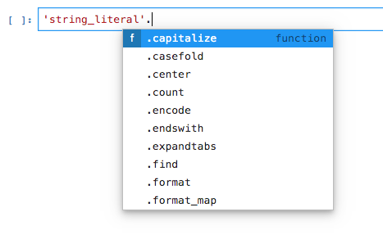
Use dir() and autocomplete to see functions
[ ]: dir('string literal')
['__add__',
...
'capitalize',
'casefold',
'center',
...
'upper',
'zfill']

Slide 12

Classes, types, and even functions are objects
[ ]: dir(Point.isOrigin)
['__annotations__',
'__call__',
...
'__str__',
'__subclasshook__']
[ ]: Point.isOrigin.__str__()
'<function Point.isOrigin at 0x107e3fd90>'

Slide 13
Python packages
A package is a set of Python modules and scripts (and possibly C, Fortran, etc. supporting code) that can be installed in a Python environment
Install packages directly from PyPI using pip
pip installs recurse through dependencies
[ajk@holy2a]$ pip install Flask-Script
Collecting Flask-Script
Downloading Flask-Script-2.0.5.tar.gz (42kB)
100% |████████████████████████████████| 51kB 710kB/s
Collecting Flask (from Flask-Script)
Downloading Flask-0.12-py2.py3-none-any.whl (82kB)
100% |████████████████████████████████| 92kB 2.0MB/s

Slide 14
Virtual environments
Virtual environments mitigate package conflicts
Makes a copy of the system python into the current directory
Install packages within that environment without effecting others
Multiple environments can be maintained and named
Types of virtual environments
virtualenv (use pip install)
Anaconda (also provides the conda package management tool)

Slide 15
Map against a virtual digest
Perform a virtual restriction fragment digest on chromosome 12 and map the annotated samples to the largest fragments
Read the chromosome 12 sequence
Cut it with the BisI restriction enzyme (recognizes GCAGC, GCTGC, GCGGC and GCCGC)
Sort the unique fragments by size
Write the 3 largest fragments to 3 separate FASTA files
Run minimap2 with the annotated samples against each of the 3 largest fragments

